Slide 1
Used Books
Web Application

Slide 2
Contents
Overview
Structure and Technologies
Detailed Contents

Slide 3
Overview

Slide 4

Overview
The web application facilitates the awareness of availability of used books
This will create equal opportunities to students to get the information with affordable costs

Slide 5
Structure and Technology

Slide 6
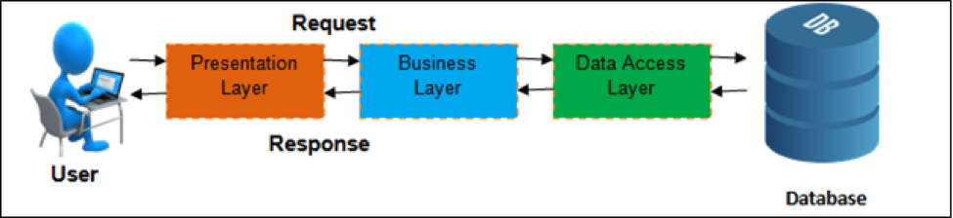
Structure and Technologies
The application is built using MVC design pattern
Frontend
SQL Server Express
Razor Pages
Bootstrap
Business Layer
ASP .net Core
Data Access Layer
Entity Framework Core
Database

Slide 7
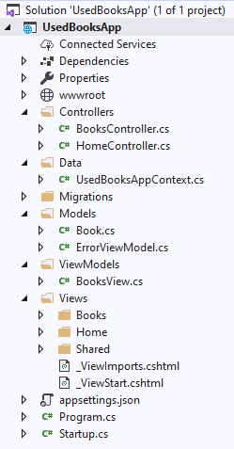
Structure and Technologies
The application has two parts
Static part where the frontend contents are fixed
Dynamic part where the books CRUD takes place
Controllers
Two controllers were created for this application one controller for the static application part
Models
Since the application uses books images to display the books details, we needed to have another model class in order to enable the file upload controller to get generated by Razor pages

Slide 8
Detailed Contents

Slide 9
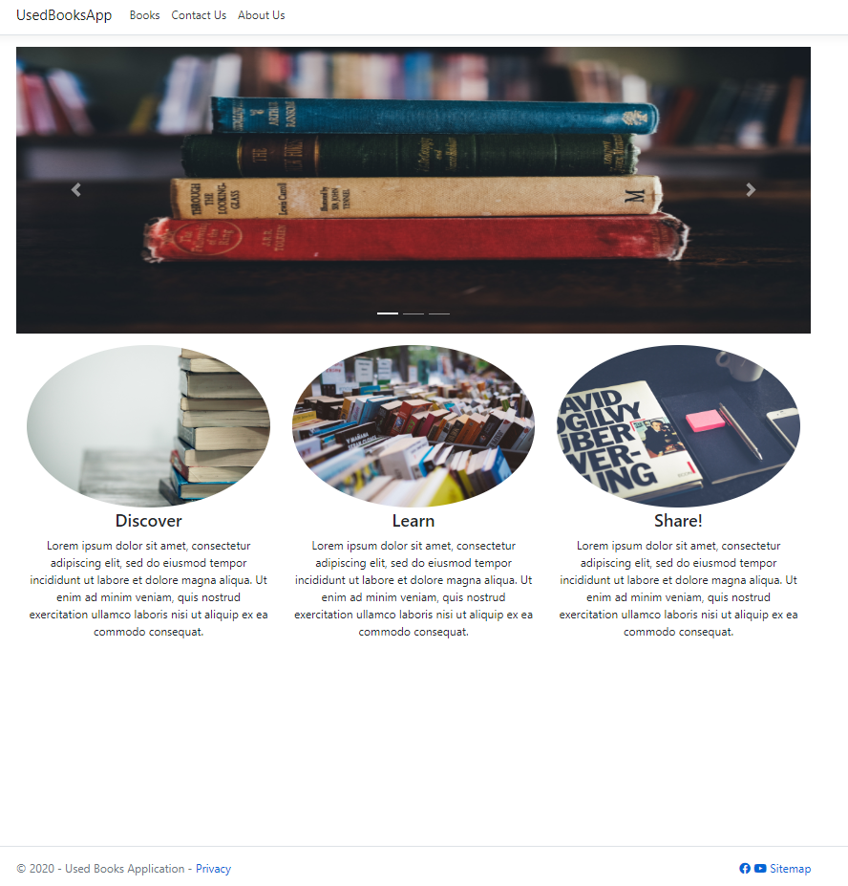

Detailed Content – Home Page
Header
With navigation bar
Contents
With responsive columns
Footer
With font awesome

Slide 10
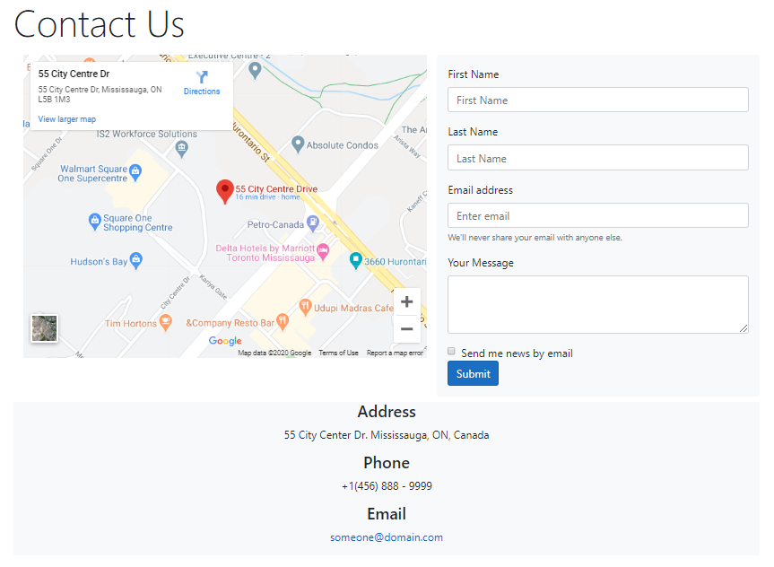
Detailed Content
Contact Us
Embedded map
Form

Slide 11
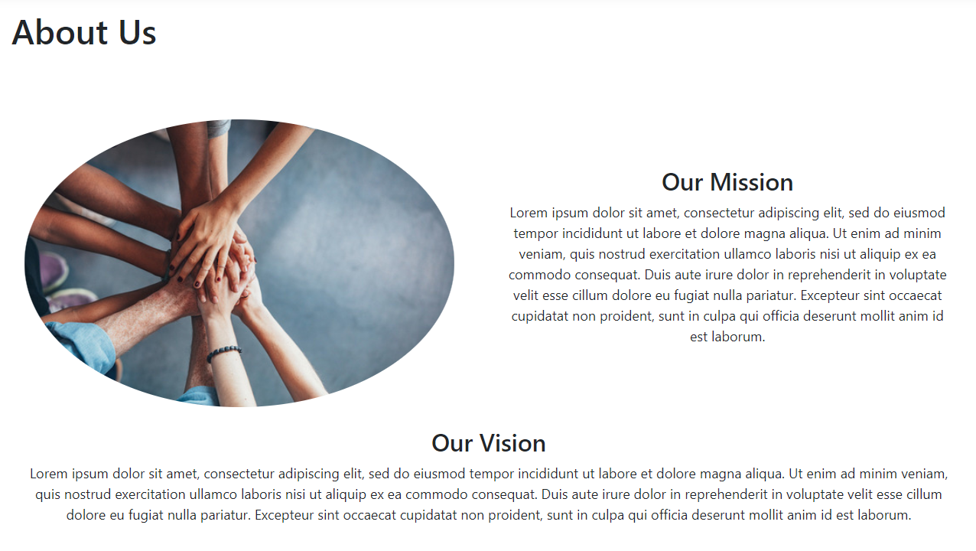
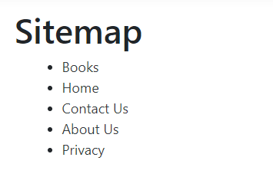
Detailed Contents
About Us and Sitemap

Slide 12
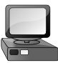
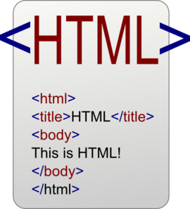

Detailed Contents
Models
Client / Web browser
Response
Request
Controller
BookView Class
Book Class
With Image property of IFileForm type
With Image property of String type

Slide 13
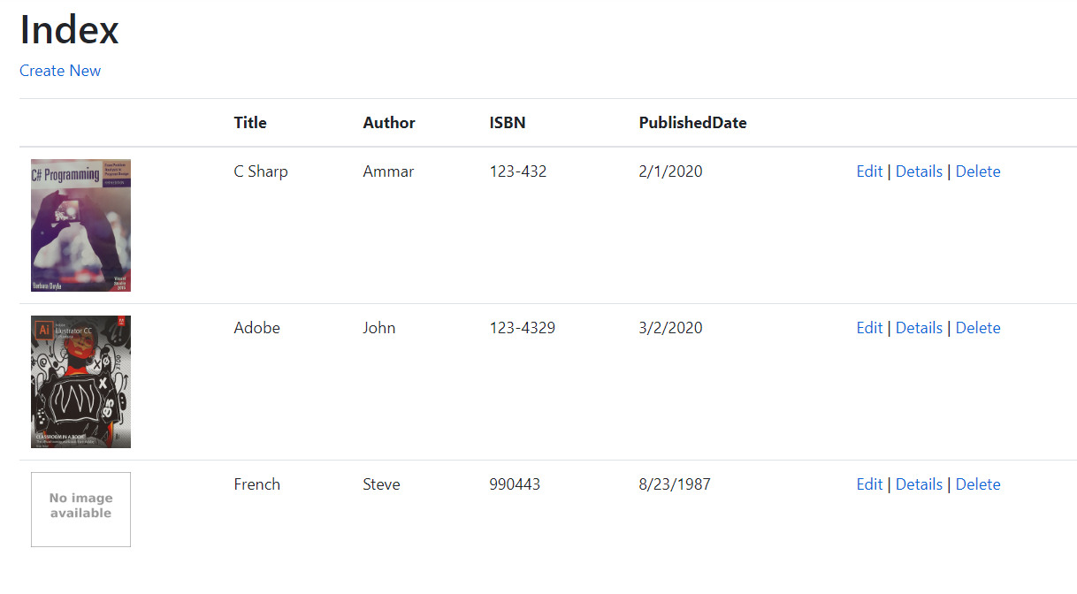
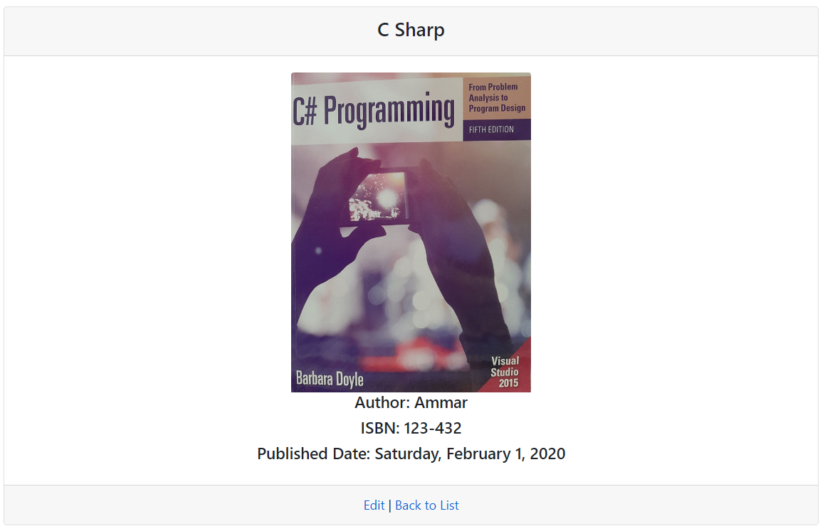
Detailed Contents
List and Book Details

Slide 14
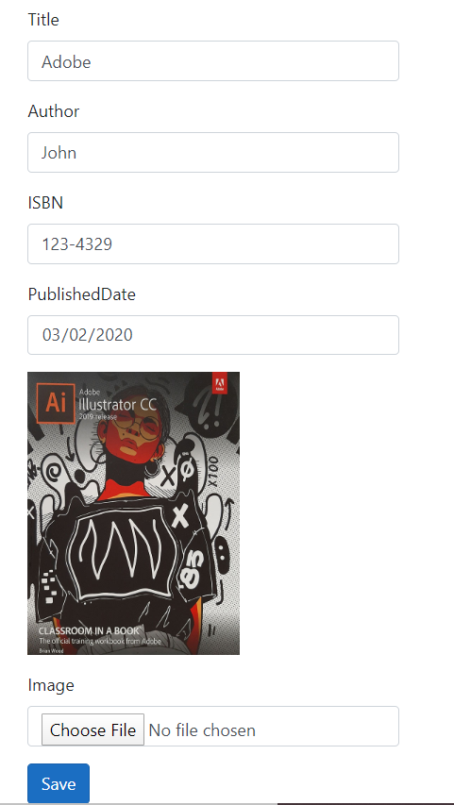
Detailed Contents
List and Book Details
Adding and Editing Existing Books
The iFormFile makes Razor pages to generate input HTML tag of File type.
Only file name is stored in the Database

